Slide 1
Investor Attention to Bank Risk During the Spring 2023 Bank Run
Natalia Fischl-Lanzoni (NYU), Martin Hiti (FRBNY), Nathan Kaplan (HBS)
and Asani Sarkar (FRBNY)
23rd Bank Research Conference, FDIC
September 19, 2024
The views stated here are those of the authors and do not necessarily reflect the views of the Federal Reserve Bank of New York, or the Federal Reserve System.

Slide 2
Investor Attention to Bank Risk
Speed of SVB bank run suggests investors were surprised
  How did they update beliefs about bank risk before and during run?
  Do they update using all relevant information? Or
  Do they have limited attention capacity, only focusing on salient information?
  Affects what market participants & policymakers can learn from price dynamics during the run
Study investor perception of bank balance sheet (BS) risk using stock returns
  Changes over time and across banks as information arrived

Slide 3
Content
Methodology:
  Bank risk measure
  Information arrival proxies
Informativeness of rating announcements
How did perceptions of bank risk change during the run?
How did perceptions of bank risk change in 2022?
Conclude

Slide 4
Bank Balance Sheet Factor Beta
Daily measure of bank risk: BS factor beta
  Exclude failed & DG banks from factor construction to avoid mechanical effects
    Failed banks are excluded from all analysis
  Sort banks by BS variables in 2022Q4
    UID: uninsured deposits/assets
    HTM+AFS losses/assets
    Cash/assets
    CET1
  High-low returns of bank portfolios
  Consider Call Report submission deadlines (so part of investors’ information set)

Slide 5
Cross-section of Information & Bank Risk
Use ratings announcements as proxies for information arrival during run
4 groups of banks:
  5 banks put on DGW by Moody's on March 14
  12 banks DG between April 14 - 21 (including DGW banks)
  38 non-DG regional banks: in KRX
  23 Stress-tested banks: in 2022 stress tests + in KBW
All banks other than stress-tested group appeared risky in 2022Q4
  Including non-DG regional banks
  March: highest UID; April: highest Losses

Slide 6
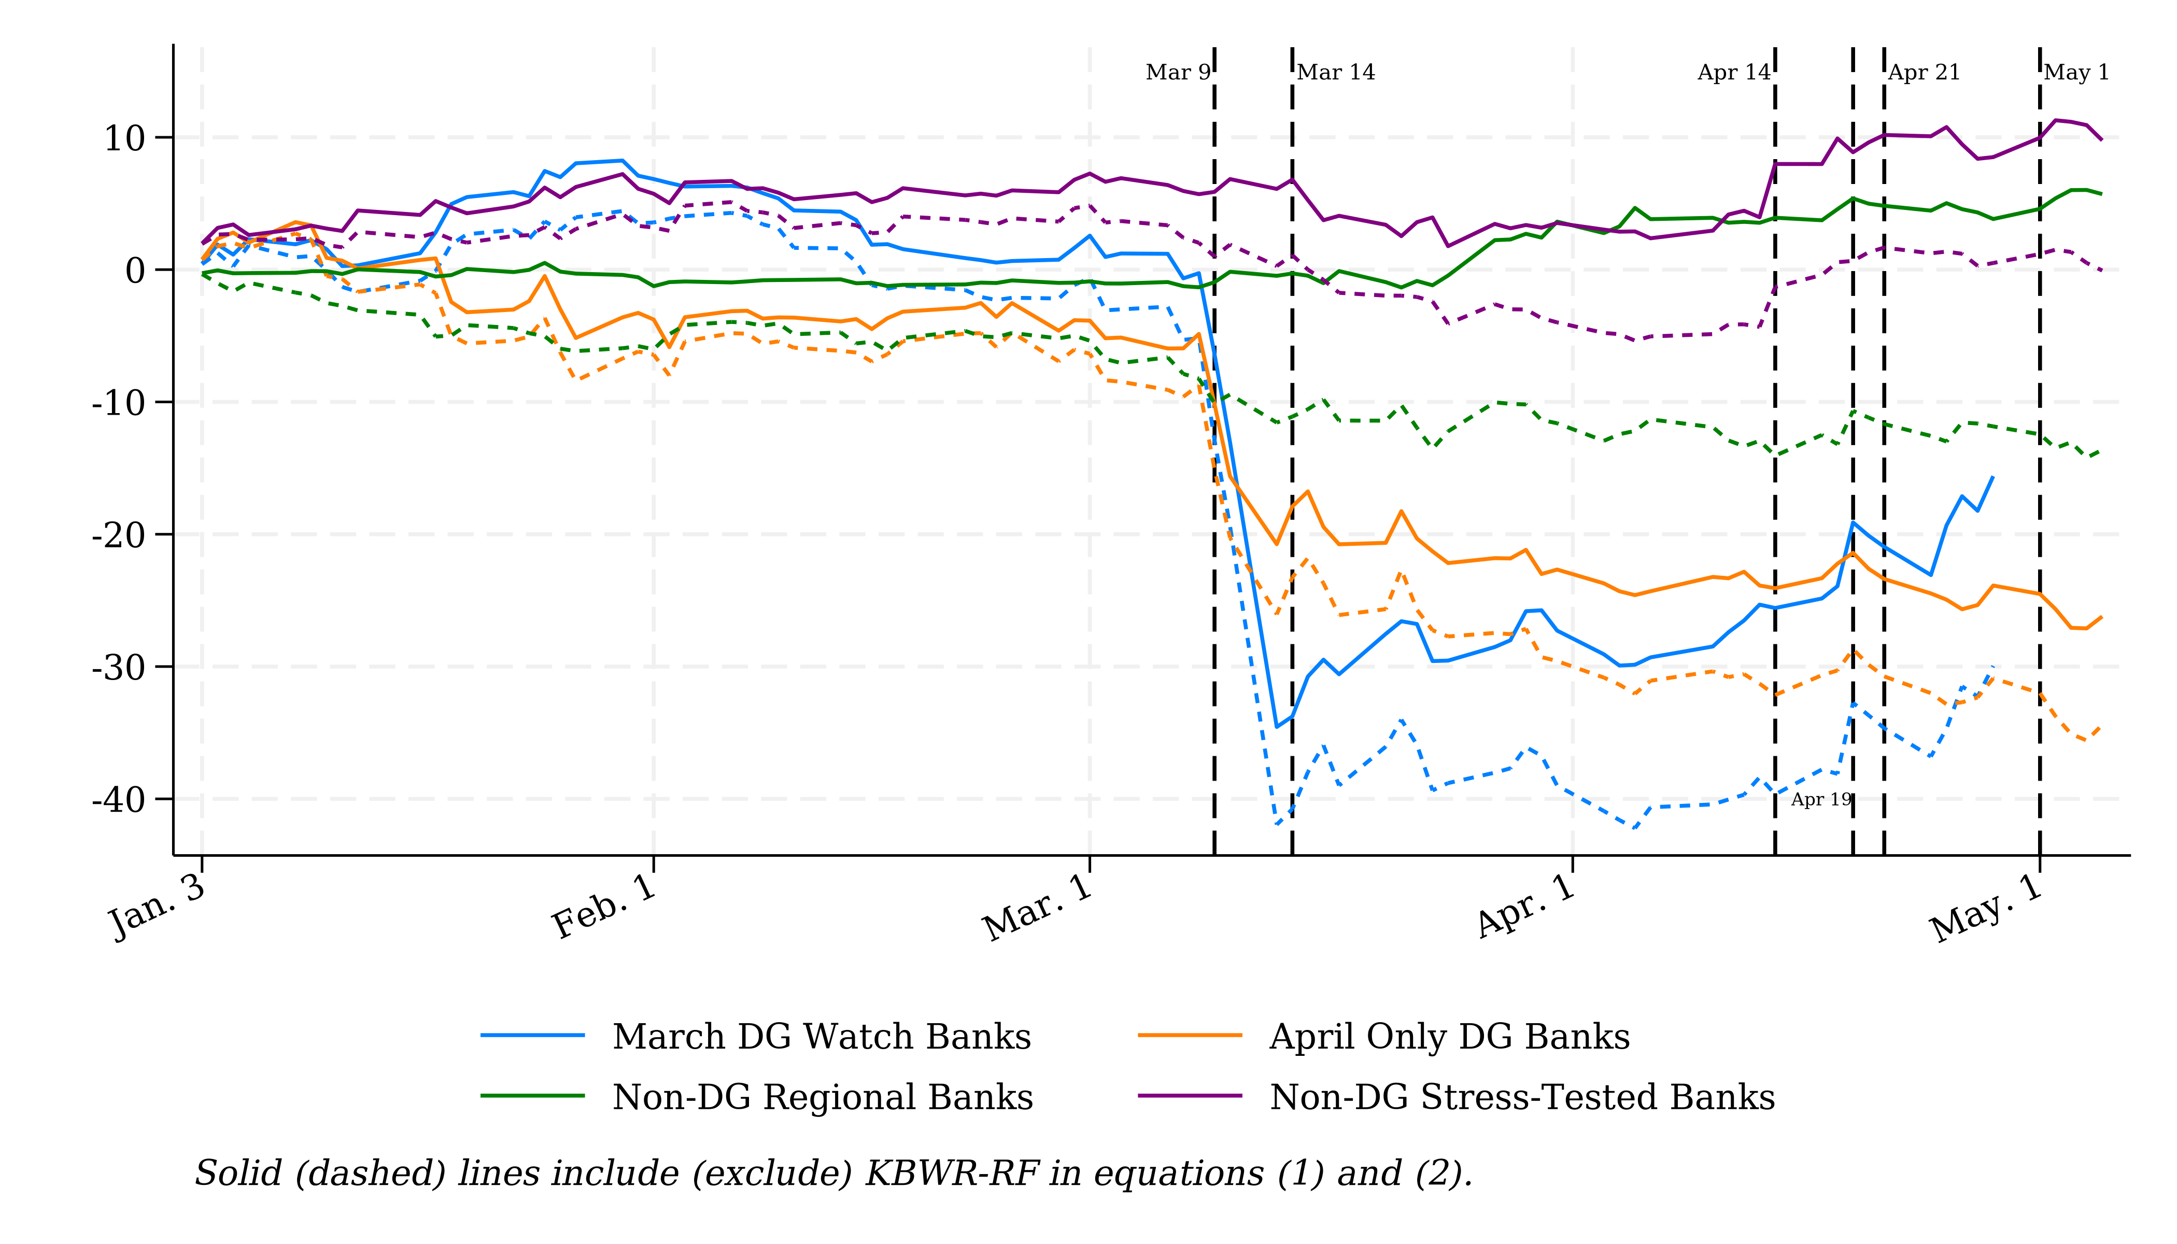
Are Rating Announcements Informative?
Are abnormal returns negative on announcement day?
Calculate abnormal returns from Fama-French 5 factor model (+ regional bank index to account for crisis effects) estimated using 2022 data
Result: rating announcements are not informative
Figure: Cumulated Abnormal Stock Returns in 2023, by Bank Group

Slide 7
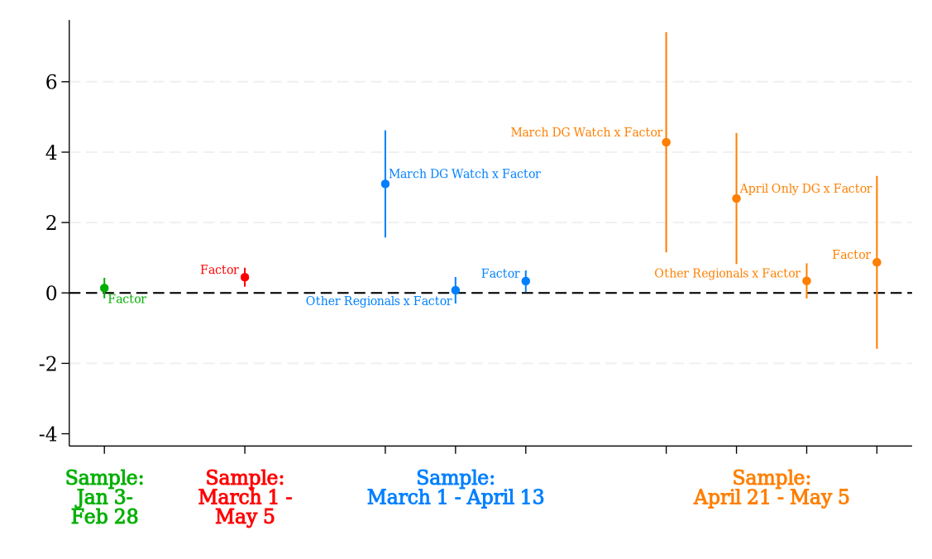
How did Investors Update Beliefs Following Run?
Investors become more sensitive to bank risk after run
But they update beliefs of bank risk only for event banks
Figure: Estimated Betas for Factor = UID

Slide 8
Leave One Out Analysis
Small number of banks may induce idiosyncratic effects
  Leave one event bank out and re-estimate
Results are robust

Slide 9
Limited Attention vs Prediction Model
Possible explanations:
  H1: Investors have limited attention capacity and coordinate on announcements to update their beliefs
  H2: Investors have an accurate prediction model and focus on the same set of banks as rating agencies (consistent w uninformative ratings)
Tests: estimate beta for 10 days pre- & post-announcement
  H1: Identify announcement effects on betas of event banks
  H2: Beta changes for event + other risky banks precede announcement days

Slide 10
Crisis Effects vs Prediction Model
Could the results for March 1-13 be wholly due to the bank run?
  Repeat excluding March 9-13
  Similar results, consistent w BS risk (March DWG UID; April Losses)
Investors did not coordinate on rating announcements
Investors focused on event banks but also wrongly considered stress-tested banks as risky
Did not consider non-DG regional banks as risky
Consistent with a naïve prediction model (e.g., based on size alone)

Slide 11
Betas increased for large banks

Slide 12
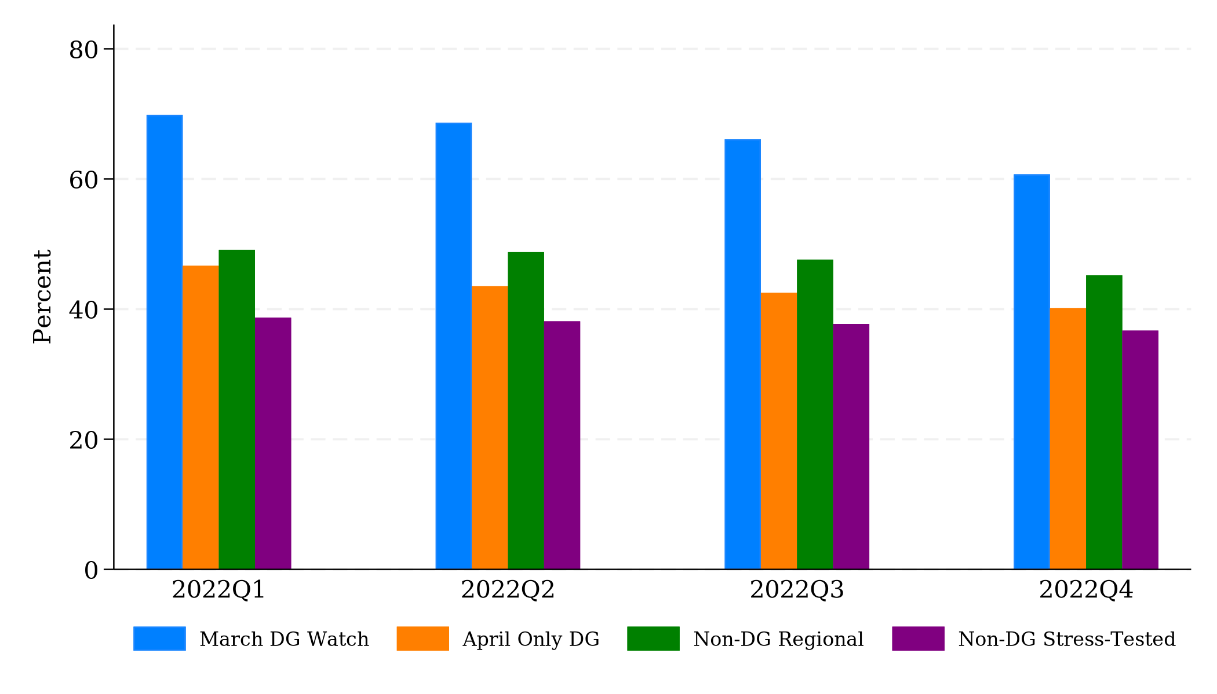
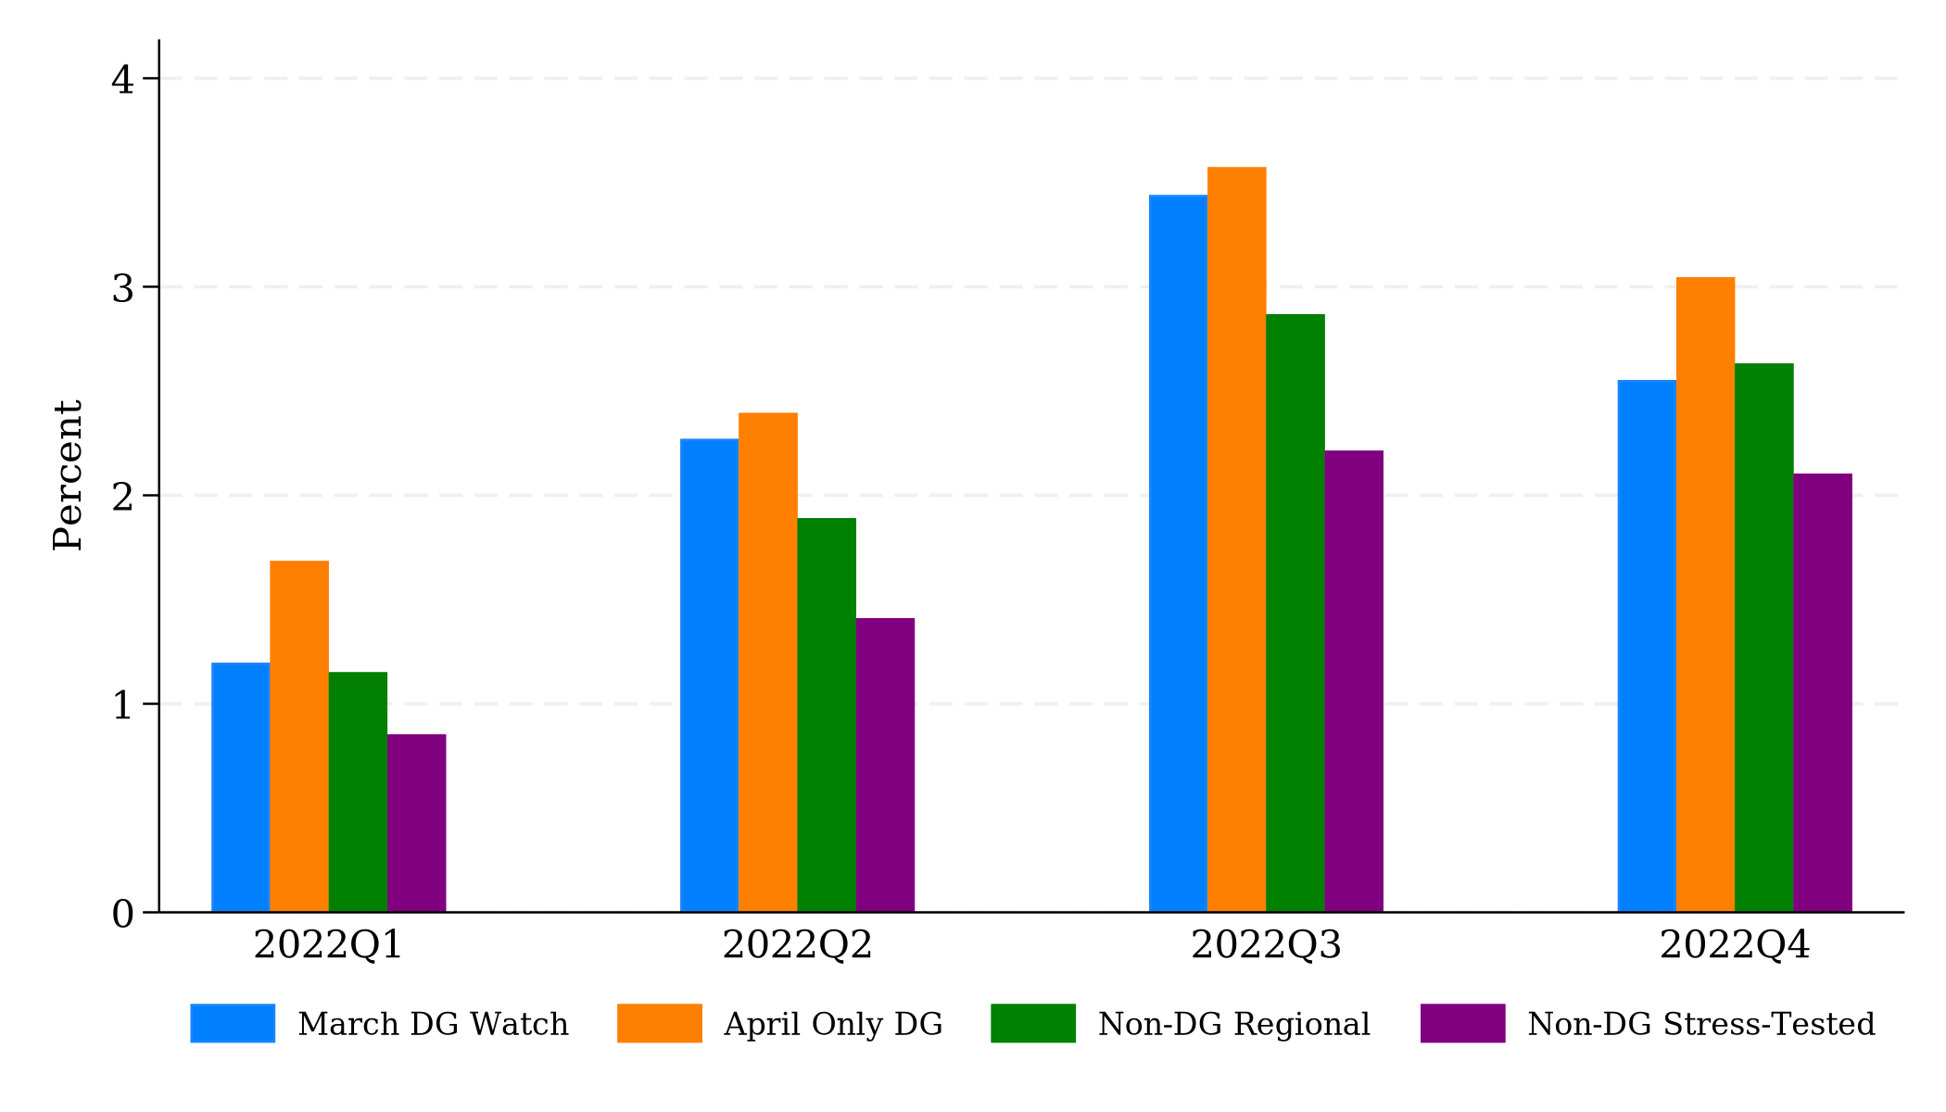
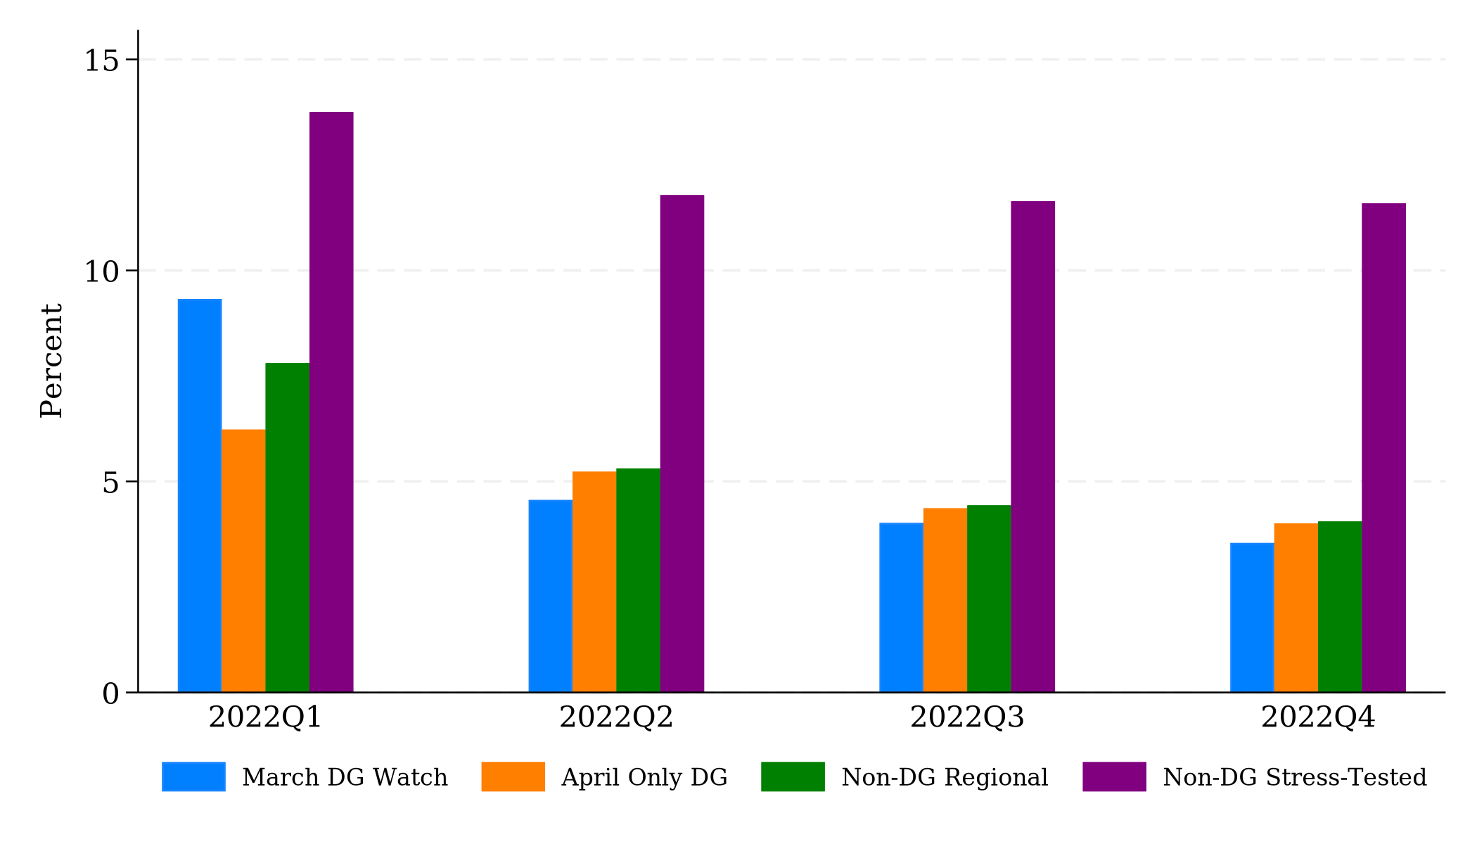
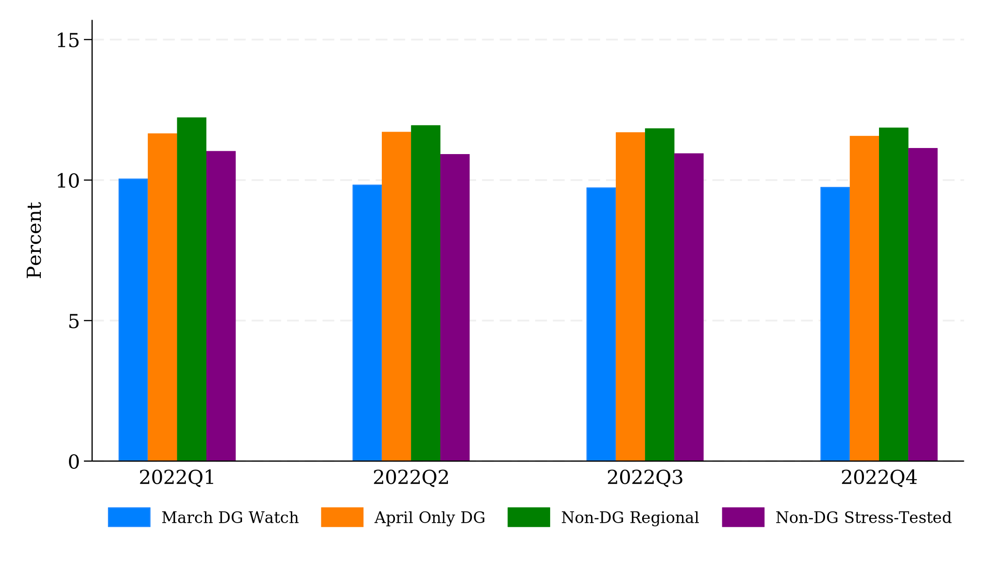
What about 2022?
Predictability in 2022?
Bank balance sheet risk was apparent from regulatory data in 2022
Figure: Bank Balance Sheet Characteristics in 2022, by Bank Group
(a) UID
(b) Losses
(c) Cash
(d) CET1

Slide 13
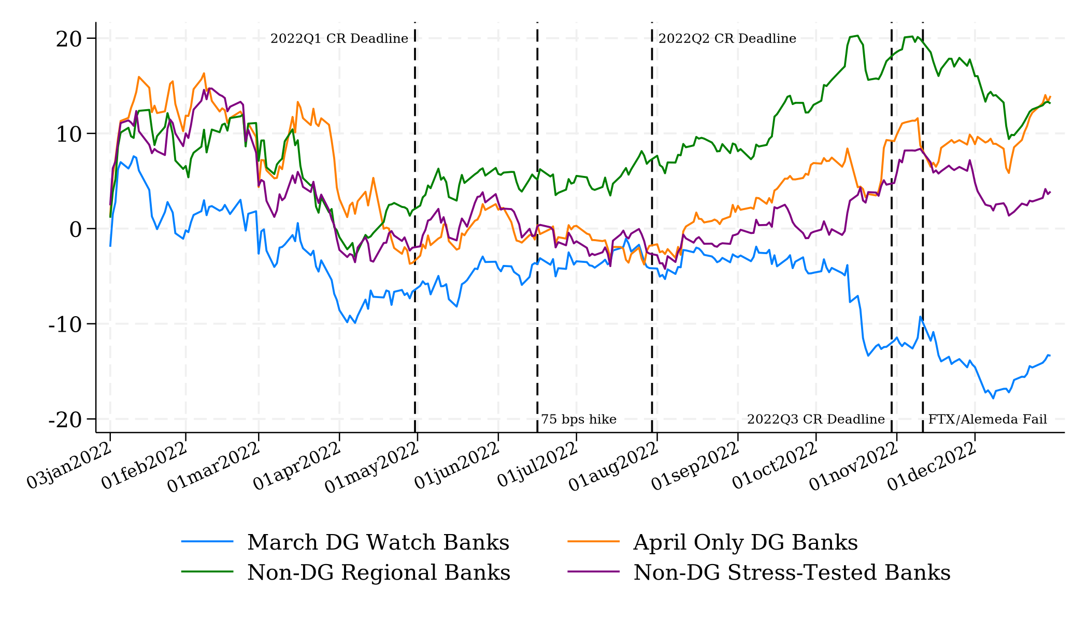
Responses of Bank Returns to Information in 2022
Information in 2022: Fed rate hikes, CR submission DLs, crypto winter in Q4
March DGW bank returns fall in Q42022 (familiarity w UID but not Losses?)
Figure: Cumulated Abnormal Stock Returns in 2022, by Bank Group

Slide 14
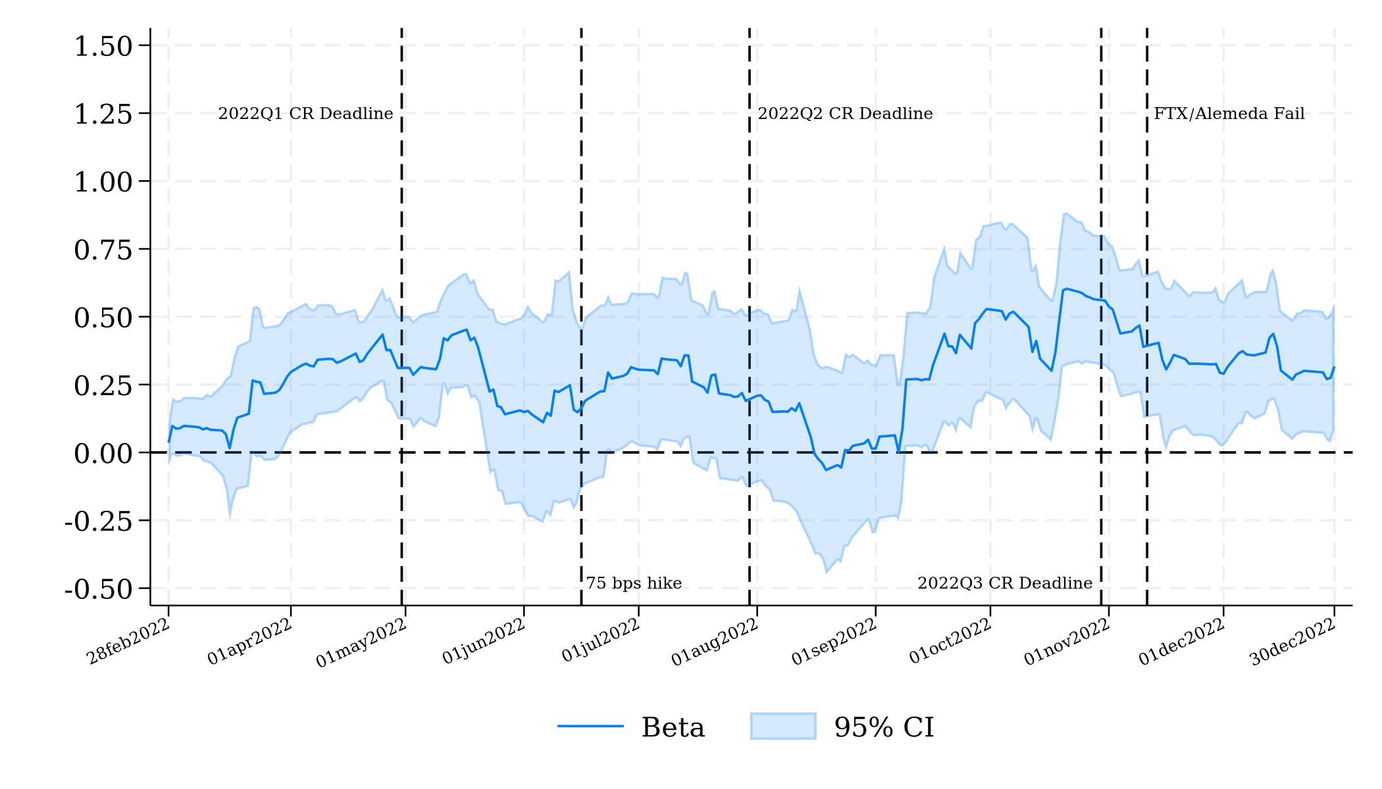
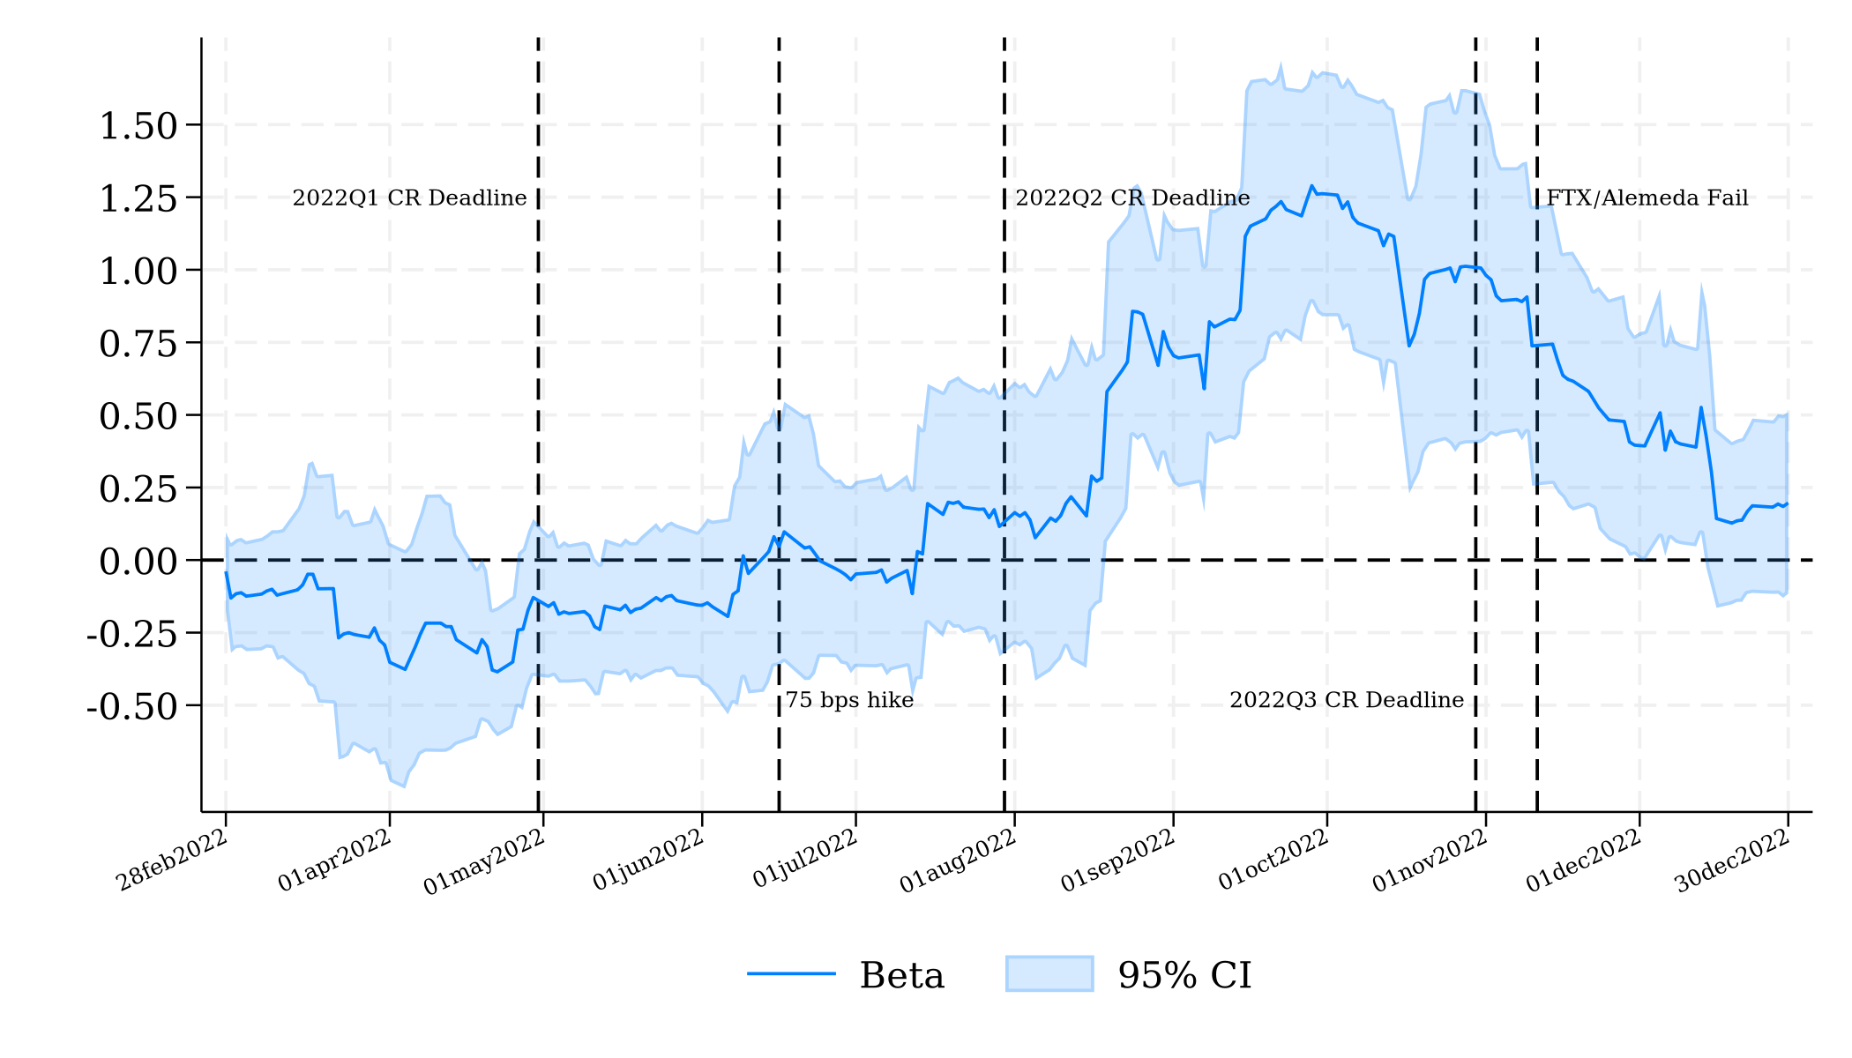
Perceptions of Bank Risk in 2022
Estimate rolling window betas
Temporary effects on beta around rate hikes and crypto events
  Consistent w lack of persistent attention to bank risk
All betas become insignificant by start of 2023
  Did March DGW bank betas decline even during Jan-Feb 20223?
Figure: Bank Balance Sheet Factor Betas in 2022
(a) UID
(b) Losses

Slide 15
Conclusions
Investors’ bank BS betas increase on average after bank run, but only for banks that were downgraded by rating agencies, even though the rating announcements were not informative
This effect cannot be explained by the idea that investors with limited attention coordinate on the rating announcements
Evidence is consistent with investors having a naïve prediction model
  They correctly update the risk of event banks in March 1-8 (before announcements)
  They also erroneously predict stress-tested banks to be risky and ignore non-downgraded regional banks
Future work:
  Estimate investor prediction model
  Higher frequency measures of information arrival during bank run

